Slide 1

Reading ability as a protective factor for word learning among school-aged low socioeconomic status children
Julie M. Schneider
Alyson D. Abel
Mandy J. Maguire

Slide 2

Notes:
A child’s ability to learn new words is foundational for subsequent language growth and academic success.

Slide 3
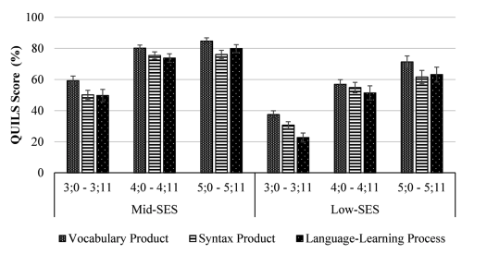
Image from Levine et al., 2020
Notes:
However, recent evidence suggests that pre-school aged children from lower socioeconomic status (SES) homes perform well below their peers on measures of language learning

Slide 4
Stress
Home Language Environment
Caregiver Education
Access to Resources
SES
Achievement Outcomes
Reading Ability
Math Skill
Parental Sensitivity
Nutrition
Vocabulary Knowledge
Child Care Quality
Notes:
While various mechanisms have been identified as contributing to these SES-related differences in achievement outcomes, there are three mechanisms which are commonly associated with SES-related differences in language learning during infancy and preschool:
the child’s home language environment,
reading ability,
and vocabulary knowledge.

Slide 5
Home Language Environment
SES
Language Learning
Reading Ability
Vocabulary Knowledge
Notes:
While various mechanisms have been identified as contributing to these SES-related differences in achievement outcomes, there are three mechanisms which are commonly associated with SES-related differences in language learning during infancy and preschool:
the child’s home language environment,
reading ability,
and vocabulary knowledge.

Slide 6

Home Language Environment
Better quantity and quality of language input are related to higher levels of parental education (Pace et al., 2017; Huttenlocher et al., 2010; Hoff, 2003).
Home literacy environment also matters (Hutton et al., 2015; 2017):
Children from lower SES homes own fewer books and engage in fewer reading experiences
Disadvantageous for existing linguistic knowledge
(Luo et al., under review; Froiland, Powell, Diamond, & Son, 2013; Mol & Bus, 2011; Farver et al., 2006)
Notes:
Related to the home language environment, parents with higher levels of education generally provide t, ask more questions, and engage in more contingent conversations with children (Pace et al., 2017; Huttenlocher et al., 2010; Hoff, 2003).
As Daniela brought to light in her talk, the home literacy can also influence language outcomes (Hutton et al., 2015; 2017) , such that children from lower SES homes tend to own fewer books and engage in less frequent book-reading experiences than children from higher SES homes, potentially leading to disadvantages in existing linguistic knowledge, such as vocabulary knowledge, oral language, and emergent reading skills (Luo et al., under review; Froiland, Powell, Diamond, & Son, 2013; Mol & Bus, 2011; Farver et al., 2006).

Slide 7
Reading Ability and Vocabulary Knowledge
Growth in these scaffold a deeper understanding of word meanings and ease sentence comprehension (Luo et al., under review; Hill & Wagovich, 2020; Maguire, et al., 2018; Hill et al., 2017; Weisleder & Fernald, 2013; Cain, Oakhill, & Elbro, 2003).
Word learning is most affected by poor reading AND vocabulary (Cain, Oakhill & Lemmon, 2004).
Chart is an adaptation of results from Cain, Oakhill & Lemmon (2004)
Notes:
Children’s reading ability and vocabulary knowledge are also critical contributors to word learning ability: growth in these scaffold a deeper understanding of word meanings and ease sentence comprehension, ultimately benefitting word learning (Luo et al., under review; Hill & Wagovich, 2020; Maguire, et al., 2018; Hill et al., 2017; Weisleder & Fernald, 2013; Cain, Oakhill, & Elbro, 2003).
In a study of school-aged-children, word learning was not affected by poor reading comprehension alone but by combined poor reading comprehension and vocabulary (Cain, Oakhill & Lemmon, 2004).

Slide 8
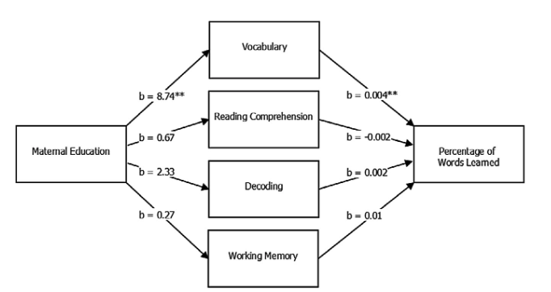
Reading Ability and Vocabulary Knowledge
Vocabulary knowledge has also been shown to mediate SES-related gaps in word learning ability (Maguire et al., 2018)
Image from Maguire et al. (2018)
Notes:
Vocabulary knowledge has also been shown to mediate SES-related gaps in word learning ability (Maguire et al., 2018), adding to evidence that an individual’s language abilities may interact with their SES environment.

Slide 9
Does the relationship between SES & word learning differ across the school years?
Do individual differences in a child’s vocabulary and reading abilities effect word learning across SES strata?
Notes:
Therefore, we first examined whether the strength of the effect of SES, and home literacy environment, on word learning varies across the school years?
And second, whether individual variability in a child’s vocabulary knowledge or reading abilities differentially affect word learning during the school years across SES strata?

Slide 10
124 school-aged children, ages 8-16 years
Low SES
Mid SES
High SES
Maternal Education | <7th grade | <9th grade | Partial High School | High School | Some College | College Degree | Graduate Degree | p-value
N | 5 | 12 | 9 | 11 | 17 | 45 | 25
Bilingual Language Experience [mean (SD)] | -1.15 (1.18) | -0.91 (0.84) | -1.26 (0.75) | -0.80 (0.89) | 0.27 (0.77) | 0.58 (0.60) | 0.28 (0.84) | <0.001
Number of females (%) | 4 (80.0) | 7 (58.3) | 7 (77.8) | 7 (63.6) | 5 (29.4) | 20 (44.4) | 14 (56.0) | 0.152
Age in years [mean (SD)] | 11.67 (2.61) | 10.84 (2.10) | 11.39 (2.57) | 11.40 (2.24) | 11.44 (2.05) | 11.34 (2.08) | 11.48 (2.20) | 0.989
Notes:
One-hundred and twenty-four school-aged children ages 8-16 years participated in this study.
Maternal ed as a proxy for SES. (add continuous line above mat ed to represent their SES)
Children were roughly the same age across SES-strata; however, they did differ in dual language exposure. Children from households where mothers had lower levels of education were more likely to have exposure to both English and Spanish, the negative number here, than those from households with a higher level of maternal education, the positive number here. We control for this in subsequent analyses.

Slide 11
Sentence within Triplet | Example
Sentence 1 | It gets hot when we turn on the bown.
Sentence 2 | Dinner is cooking in the bown.
Sentence 3 | She baked the cookies in the bown.
Notes:
For the word learning from context task, children read sentences which were presented one word at a time.
Sentences were presented in triplets and each triplet ended with the same pseudoword. Children were instructed that some sentence triplets would scaffold meaning acquisition (Meaning condition), while others would not (No Meaning). The sentence which did not were a control condition that we do not focus on here.
After the presentation of all three sentences, a trained experimenter asked the child if the “made up word, bown in the current example, represents a real word, and if so, what word?”.
A correct response for the current example would be oven.
All words in the sentences had an early age of acquisition.

Slide 12
Low SES
Mid SES
High SES
Maternal Education | <7th grade | <9th grade | Partial High School | High School | Some College | College Degree | Graduate Degree | p-value
N | 5 | 12 | 9 | 11 | 17 | 45 | 25
Word Learning Percent Correct [mean (SD)] | 0.43 (0.15) | 0.51 (0.27) | 0.52 (0.20) | 0.55 (0.17) | 0.62 (0.22) | 0.69 (0.21) | 0.73 (0.16) | 0.001
Vocabulary [mean (SD)] | 83.40 (21.55) | 97.00 (17.59) | 96.89 (9.49) | 97.00 (14.35) | 107.06 (11.65) | 116.71 (15.33) | 121.24 (13.82) | <0.001
Reading Overall [mean (SD)] | 88.00 (11.55) | 91.08 (11.11) | 90.67 (11.88) | 88.27 (11.33) | 93.94 (10.86) | 108.60 (15.35) | 108.24 (14.28) | <0.001
Notes:
We found that, across SES strata, children significantly differed in the performance on the WL from context task.
We also measured receptive vocabulary knowledge using the Peabody Picture Vocabulary Test–Fourth Edition (PPVT-4) and reading ability was measured using the Gray Oral Reading Tests–Fifth Edition (GORT-5).
They also significantly differed in vocabulary knowledge and reading ability.

Slide 13
Low SES
Mid SES
High SES
Maternal Education | <7th grade | <9th grade | Partial High School | High School | Some College | College Degree | Graduate Degree | p-value
N | 5 | 12 | 9 | 11 | 17 | 45 | 25
Home Literacy Environment* [mean (SD)] | -0.67 (0.57) | -0.01 (1.34) | 0.01 (1.06) | -0.48 (0.36) | -0.45 (0.34) | 0.27 (1.06) | 0.27 (1.35) | 0.068
Notes:
We also measured home literacy environment was measured as a composite of # of books in the home (0-10, 11-100, 101-500, 500+), minutes child is read to on average, and minutes child reads on average as reported by the parent (Luo et al., under review).

Slide 14
Does the relationship between SES & word learning differ across the school years?
Notes:
Hierarchical linear regression analyses were conducted to address the question of whether the strength of the effect of SES and home literacy environment on word learning varies as children progress through school.
Animate
While age, SES, and home literacy environment positively predict word learning ability independently, SES differences remain stable from age 8 to 16 years, indicated by non-significant interactions between SES and child age (see Model 3 in Table 3; Figure 2).
Animate
a stronger association between home literacy environment and word learning accuracy in younger children (approximately 13.5 years and younger;
These findings suggest the home literacy environment maintains a critical role in word learning ability during the school years, but that its role may diminish as children progress through school.

Slide 15
Do individual differences in a child’s vocabulary and reading abilities effect word learning across SES strata?
Word Learning accuracy ~ vocabulary knowledge x Age x SES
(controlling for dual language exposure, home literacy environment, and reading ability)
Word Learning accuracy ~ reading ability x Age x SES
(controlling for dual language exposure, home literacy environment, and reading ability)
Notes:
To address the question of whether individual differences in a child’s language abilities effect word learning across SES strata, we computed two multiple regression models.
The first included a three way interaction term between vocabulary knowledge, age, and SES, controlling for reading ability
The second included a three way interaction term between reading ability, age, and SES, controlling for vocabulary knowledge
Both models also controlled for a child’s exposure to multiple languages and their home literacy environment.

Slide 16
Does individual variability in a child’s vocabulary knowledge differentially affect word learning during the school years across SES strata?
Age in months (b = 0.26, S.E. = 0.10, p = 0.02, d = 0.45, 95% CI [0.32, 0.59]) & Vocabulary knowledge (b = 0.005, S.E. = 0.001, p < 0.001, d = 0.42, 95% CI [0.22, 0.61])
positively predicted word learning accuracy.
Dual language exposure, home literacy environment, and reading ability were included as covariates in the model.
Notes:
The first model, investigating the role of vocabulary knowledge revealed that age in months and vocabulary knowledge positively predicted word learning accuracy, independent of one another.

Slide 17
Does individual variability in a child’s reading ability differentially affect word learning during the school years across SES strata?
Both reading ability (b = 0.003, S.E. = 0.001, p= 0.05, d = 0.2, 95% CI [0.02, 0.38]) & vocabulary knowledge (b = 0.005, S.E. = 0.001, p < 0.001, d = 0.38, 95% CI [0.19, 0.57]) were associated with word learning success.
Dual language exposure, home literacy environment, and vocabulary knowledge were included as covariates in the model.
Notes:
The second model investigating the role of reading ability, revealed that both reading ability & vocabulary knowledge were associated with word learning success.
Importantly though, there was an interaction between SES, age and reading ability. This interaction revealed that for younger children (approximately 13.5 years or younger) from households where mothers had not completed college (some college and below), individual differences in reading ability significantly accounted for variability in word learning success.
This was not the case for older children and children from higher SES homes.

Slide 18
Reading Sub-Test | Age Effect | SES Effect | Age x SES Effect
Fluency | < 9.2 years | < Maternal Education | p = 0.08
Accuracy | < 9.2 years | < Maternal Education | p = 0.04
Rate | < 13.5 years | --
Comprehension | -- | --
Notes:
Given the comprehensive nature of the GORT ORI reading measure, we conducted posthoc multiple regression analyses on the subtests that comprise the overall reading measure to better clarify this interaction effect was driven by individual differences in reading rate, fluency, accuracy and comprehension.
Fluency and accuracy were significant predictors of word learning in children under the age of 9.2 years, while reading rate was a significant predictor of word learning success in all children up to 13.5 years old.
Fluency and accuracy were also significant predictors of word learning in children from low SES.
And Accuracy emerged as a significant predictor of word learning success in young children from low SES homes, potentially driving the larger omnibus effect previously shown.

Slide 19
Reading accuracy represent the number of words a child pronounces correctly when reading a passage.
Word recognition during the school years is best measured by reading accuracy in the early grades (Language and Reading Research Consortium, 2015).
Early intervention on a child’s reading accuracy is important, as these skills bootstrap the ability to consume more complex texts and learn new words (Catts, Compton, Tomblin & Bridges, 2012; Language and Reading Research Consortium, 2015).
These early interventions might be especially beneficial for children coming from lower SES environments
Notes:
So what applicable relevance does reading accuracy have on language learning outcomes in school?

Slide 20
Higher SES and a richer home literacy environment → better word learning
Reading ability and vocabulary influence this relationship
Vocabulary is the greatest predictor of word learning during the school years
Reading accuracy is especially beneficial for certain sub-groups:
Children raised in lower SES environments
Younger children
Notes:
children from higher SES homes and homes with a richer home literacy environment performed better on the word learning from context task across the board, but individual reading ability and vocabulary knowledge modulated these effects
vocabulary knowledge is a key predictor of word learning success across SES strata throughout the school years
Young children raised in lower SES environments were more likely to demonstrate strong word learning abilities if they also demonstrated superior reading accuracy and this was true, regardless of their home literacy environment and vocabulary knowledge.

Slide 21
Substantial individual variability exists in children’s word learning abilities during the school years.
Vocabulary interventions may benefit all children, while reading interventions may benefit younger children from low SES homes the most
Notes:
Perhaps the most important lesson to be learned from this study is that substantial individual variability exists in children’s word learning abilities during the school years,
Based on our data, it seems as though. cocabulary interventions may benefit all children, while reading interventions may benefit younger children from low SES homes the most
However, interventions focused on reading ability could have a “trickle down” effect, ultimately benefitting both vocabulary knowledge and word learning outcomes for children from lower SES homes.

Slide 22
ACKNOWLEDGEMENTS
The Developmental Neurolinguistics Lab, led by Mandy J. Maguire, at UT Dallas
The Language Learning Lab, led by Alyson D. Abel, at San Diego State University
GRANT FUNDING
NSF Award #1551770 (PI: MJ Maguire & AD Abel)
NSF Award #1911462 (PI: JM Schneider)
Notes:
So with that, I want to thank and acknowledge my co-authors, Mandy Maguire and Alyson Abel, as well as their labs.
I also want to thank the National Science Foundation for not only funding this project, but for my own support which allowed me the time and resources to complete this project.
I look forward to hearing your thoughts and feedback in the live Q&A!

Slide 23
Does the strength of the effect of SES and home literacy environment on word learning vary across the school years?
 | Word Learning Process
 | Model 1 |  |  | Model 2 |  |  | Model 3
 | b | S.E. | d | b | S.E. | d | b | S.E. | d
Age | .11 | .017 | .51*** | .11 | .016 | .49*** | .10 | .017 | .45***
Dual-language home experiences | .06 | .016 | .28*** | .03 | .019 | .12 | .03 | .019 | .12
Home literacy environment | .05 | .015 | .24** | .04 | .015 | .20** | .05 | .015 | .23**
SES |  |  |  | .06 | .018 | .28** | .06 | .018 | .28**
SES × Age |  |  |  |  |  |  | .002 | .015 | 9.4e-03
Home literacy environment x Age |  |  |  |  |  |  | -.03 | .02 | -0.16†
R2 |  |  | .356*** |  |  | .400*** |  |  | .404
R2 change |  |  |  |  |  | .044*** |  |  | .004
Notes:
Hierarchical linear regression analyses were conducted to address the question of whether the strength of the effect of SES and home literacy environment on word learning varies as children progress through school.
Model 1 included child age in months, dual language exposure, and home literacy environment as control variables.
Model 2 added SES
And Model 3 added an interaction term between SES and age in months and home literacy environment and age in months
Animate
SES (b = 0.058, S.E. = 0.018, p = 0.001, d = 0.28, 95% CI [0.10, 0.45]) and home literacy environment (b = 0.04, S.E. = 0.014, p = 0.007, d = 0.20, 95% CI [0.06, 0.34]) uniquely contributed to children’s ability to learn words from linguistic context,

Slide 24
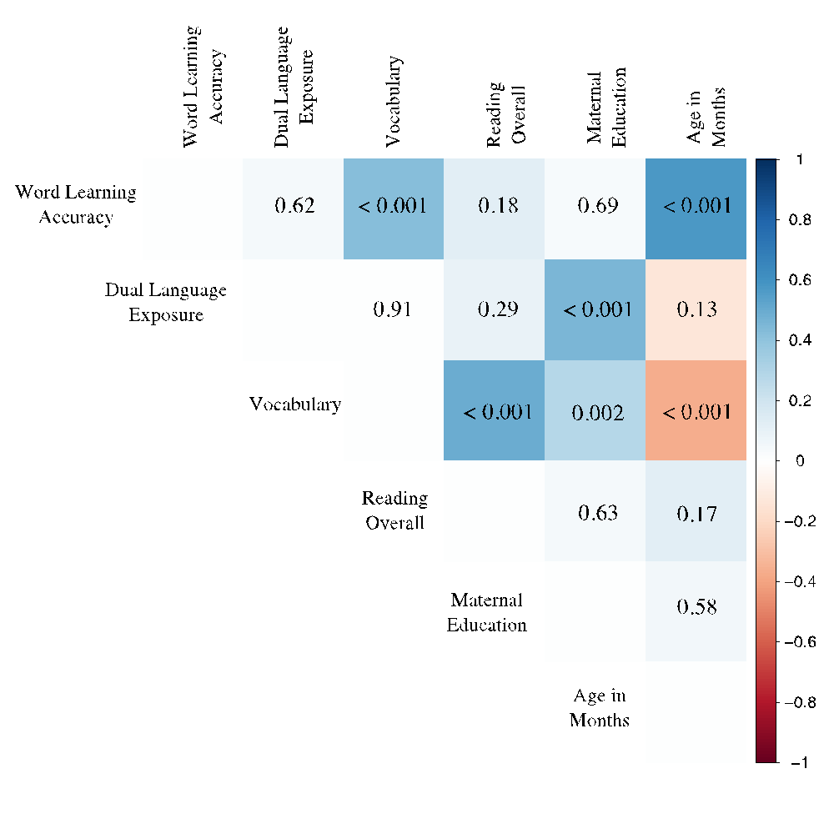
Partial correlations between variables of interest.
Pairwise correlations control for all other variables included in the larger correlation matrix.
P-values are included within the matrix, and strength/direction of the relation, as determined by the R value, are indicated by the background color (red = negative/blue = positive).
Notes:
We also measured home literacy environment was measured as a composite of # of books in the home (0-10, 11-100, 101-500, 500+), minutes child is read to on average, and minutes child reads on average as reported by the parent (Luo et al., under review).

